Slide 1
Management
Eleventh Edition
Chapter 7
Making Decisions
Copyright © 2018, 2016, 2014 Pearson Education, Inc. All Rights Reserved

Slide 2
Learning Objectives
7.1 Describe the eight steps in the decision-making process.
Develop your skill at being creative.
7.2 Explain the four ways managers make decisions.
7.3 Classify decisions and decision-making conditions.
7.4 Describe how biases affect decision making.
Know how to recognize when you’re using decision-making errors and biases and what to do about it
7.5 Identify effective decision-making techniques.

Slide 3
Be A Better Decision-Maker
A key to success in management and in your career is knowing how to be an effective decision-maker.

Slide 4

What is a Decision?
Decision—a choice among two or more alternatives
Notes:
Managers at all levels and in all areas of organizations make decisions. That is, they make choices. Although decision-making is typically described as choosing among alternatives, this view is too simplistic. Why? Because decision-making is (and should be) a process, not just a simple act of choosing among alternatives.
Source: Alex Segre/Alamy

Slide 5
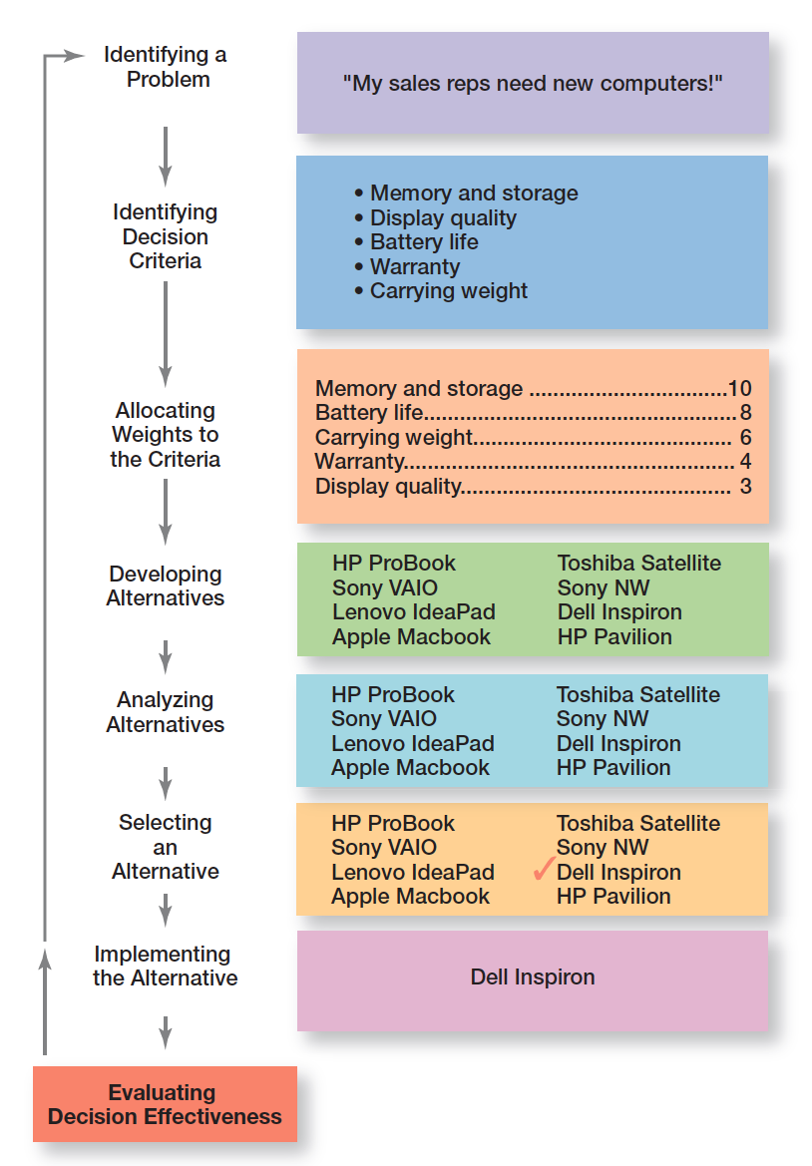
Exhibit 7-1 Decision-Making Process
Exhibit 7-1 shows the eight steps in the decision-making process. This process is as relevant to personal decisions as it is to corporate decisions.

Slide 6
Decision-Making Process Step 1: Identify a Problem
Problem: an obstacle that makes it difficult to achieve a desired goal or purpose.
Every decision starts with a problem, a discrepancy between an existing and a desired condition.
Example: Amanda is a sales manager whose reps need new laptops.
Notes:
Every decision starts with a problem, a discrepancy between an existing and a desired condition. For our example, Amanda is a sales manager whose reps need new laptops because their old ones are outdated and inadequate for doing their job. To make it simple, assume it’s not economical to add memory to the old computers and it’s the company’s policy to purchase, not lease. Now we have a problem—a disparity between the sales reps’ current computers (existing condition) and their need to have more efficient ones (desired condition). Amanda has a decision to make.

Slide 7
Decision-Making Process Step 2: Identify the Decision Criteria
Decision criteria are factors that are important to resolving the problem.
Example: Amanda decides that memory and storage capabilities, display quality, battery life, warranty, and carrying weight are the relevant criteria in her decision
Notes:
Once a manager has identified a problem, he or she must identify the decision criteria important or relevant to resolving
the problem. Every decision-maker has criteria guiding his or her decisions even if they’re not explicitly stated. In our example,
Amanda decides after careful consideration that memory and storage capabilities, display quality, battery life, warranty, and carrying weight are the relevant criteria in her decision.

Slide 8
Decision-Making Process Step 3: Allocate Weights to the Criteria
If the relevant criteria aren’t equally important, the decision maker must weight the items in order to give them the correct priority in the decision.
Example: The weighted criteria for Amanda’s computer purchase are shown in Exhibit 7-2.
Notes:
If the relevant criteria aren’t equally important, the decision maker must weight the items in order to give them the correct
priority in the decision. How? A simple way is to give the most important criterion a weight of 10 and then assign weights to the rest using that standard. Of course, you could use any number as the highest weight. The weighted criteria for our example is shown in Exhibit 2-2.

Slide 9
Decision-Making Process Step 4: Develop Alternatives
List viable alternatives that could solve the problem.
Example: Amanda identifies eight laptops as possible choices (shown in Exhibit 2-3).
Notes:
The fourth step in the decision-making process requires the decision maker to list viable alternatives that could resolve the problem. In this step, a decision maker needs to be creative, and the alternatives are only listed—not evaluated—just yet. Our sales manager, Amanda, identifies eight laptops as possible choices (see Exhibit 2-3).

Slide 10
Decision-Making Process Step 6: Select an Alternative
Choose the alternative that generates the highest total in Step 5.
Notes:
The sixth step in the decision-making process is choosing the best alternative or the one that generated the highest total in Step 5. In our example (Exhibit 2-4), Amanda would choose the Dell Inspiron because it scored higher than all other alternatives (249 total).

Slide 11
Decision-Making Process Step 7: Implement the Alternative
Put the chosen alternative into action.
Convey the decision to those affected and get their commitment to it.
Notes:
In Step 7 in the decision-making process, you put the decision into action by conveying it to those affected and getting their commitment to it. We know that if the people who must implement a decision participate in the process, they’re more likely to support it than if you just tell them what to do. Another thing managers may need to do during implementation is reassess the environment for any changes, especially if it’s a long-term decision. Are the criteria, alternatives, and choice still the best ones, or has the environment changed in such a way that we need to reevaluate?

Slide 12
Decision-Making Process Step 8: Evaluate Decision Effectiveness
Evaluate the result or outcome of the decision to see if the problem was resolved.
If it wasn’t resolved, what went wrong?
Notes:
The last step in the decision-making process involves evaluating the outcome or result of the decision to see whether the problem was resolved. If the evaluation shows that the problem still exists, then the manager needs to assess what went wrong. Was the problem incorrectly defined? Were errors made when evaluating alternatives? Was the right alternative selected but poorly implemented? The answers might lead you to redo an earlier step or might even require starting the whole process over.

Slide 13
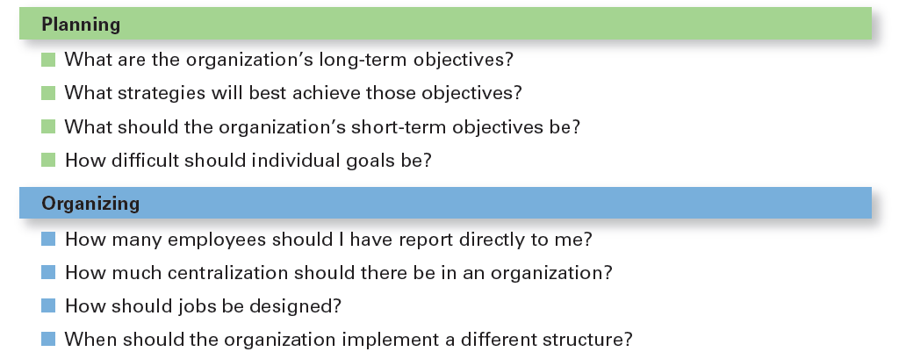
Exhibit 7-5 Decisions Managers May Make: Planning and Organizing
Notes:
Although everyone in an organization makes decisions, decision-making is particularly important to managers. As Exhibit 2-5 shows, it’s part of all four managerial functions. In fact, that’s why we say that decision-making is the essence of management. And that’s why managers—when they plan, organize, lead, and control—are called decision makers.

Slide 14
Managing Risk
Managers can use historical data or secondary information to assign probabilities to different alternatives
This is used to calculate expected value—the expected return from each possible outcome—by multiplying expected revenue by the probability of each alternative
Notes:
Under risk, managers have historical data from past personal experiences or secondary information that lets them assign probabilities to different alternatives.

Slide 15
Decision Making Biases and Errors: Heuristics
Heuristics or “rules of thumb” can help make sense of complex, uncertain, or ambiguous information.
However, they can also lead to errors and biases in processing and evaluating information.
twelve common decision errors and biases that managers make. Let’s look at each
Notes:
When managers make decisions, they not only use their own particular style, they may use “rules of thumb,” or heuristics, to simplify their decision-making. Rules of thumb can be useful because they help make sense of complex, uncertain, and ambiguous information. Even though managers may use rules of thumb, that doesn’t mean those rules are reliable. Why? Because they may lead to errors and biases in processing and evaluating information.

Slide 16
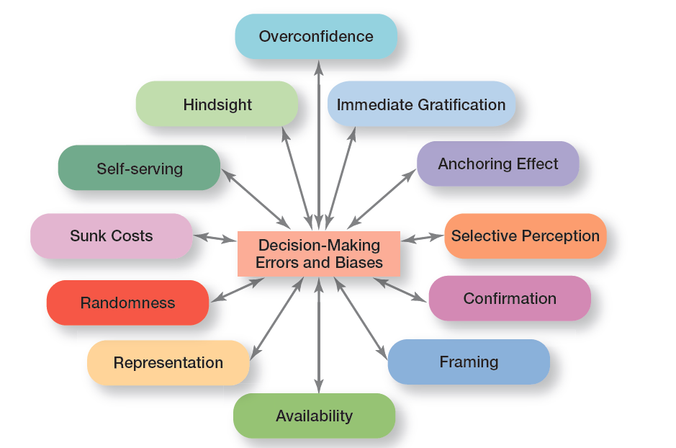
Exhibit 7-11 Common Decision-Making Biases
Exhibit 7-11 identifies 12 common decision errors of managers and biases they may have.
Notes:
Exhibit 2-11 identifies 12 common decision errors of managers and biases they may have. Let’s look at each.

Slide 17
Decision-Making Biases and Errors (1 of 4)
Overconfidence Bias: holding unrealistically positive views of oneself and one’s performance
Immediate Gratification Bias: choosing alternatives that offer immediate rewards and avoid immediate costs
Anchoring Effect: fixating on initial information and ignoring subsequent information
Notes:
When decision makers tend to think they know more than they do or hold unrealistically positive views of themselves and their performance, they’re exhibiting the overconfidence bias.
The immediate gratification bias describes decision makers who tend to want immediate rewards and to avoid immediate costs. For these individuals, decision choices that provide quick payoffs are more appealing than those with payoffs in the future.
The anchoring effect describes how decision makers fixate on initial information as a starting point and then, once set, fail to adequately adjust for subsequent information. First impressions, ideas, prices, and estimates carry unwarranted weight relative to information received later.

Slide 18
Decision-Making Biases and Errors (2 of 4)
Selective Perception Bias: selecting, organizing and interpreting events based on the decision maker’s biased perceptions
Confirmation Bias: seeking out information that reaffirms past choices while discounting contradictory information
Framing Bias: selecting and highlighting certain aspects of a situation while ignoring other aspects
Notes:
When decision makers selectively organize and interpret events based on their biased perceptions, they’re using the selective perception bias. This influences the information they pay attention to, the problems they identify, and the alternatives they develop.
Decision makers who seek out information that reaffirms their past choices and discount information that contradicts past judgments exhibit the confirmation bias.
The framing bias is when decision makers select and highlight certain aspects of a situation while excluding others. By drawing attention to specific aspects of a situation and highlighting them, while at the same time downplaying or omitting other aspects, they distort what they see and create incorrect reference points.

Slide 19
Decision-Making Biases and Errors (3 of 4)
Availability Bias: losing decision-making objectivity by focusing on the most recent events
Representation Bias: drawing analogies and seeing identical situations when none exist
Randomness Bias: creating unfounded meaning out of random events
Notes:
The availability bias happens when decisions makers tend to remember events that are the most recent and vivid in their memory. The result? It distorts their ability to recall events in an objective manner and results in distorted judgments and probability estimates.
When decision makers assess the likelihood of an event based on how closely it resembles other events or sets of events, that’s the representation bias. Managers exhibiting this bias draw analogies and see identical situations where they don’t exist.
The randomness bias describes the actions of decision makers who try to create meaning out of random events. They do this because most decision makers have difficulty dealing with chance even though random events happen to everyone, and there’s nothing that can be done to predict them.

Slide 20
Decision-Making Biases and Errors (4 of 4)
Sunk Costs Errors: forgetting that current actions cannot influence past events and relate only to future consequences
Self-serving Bias: taking quick credit for successes and blaming outside factors for failures
Hindsight Bias: mistakenly believing that an event could have been predicted once the actual outcome is known (after-the-fact)
Notes:
The sunk costs error occurs when decision makers forget that current choices can’t correct the past. They incorrectly fixate on past expenditures of time, money, or effort in assessing choices rather than on future consequences. Instead of ignoring sunk costs, they can’t forget them.
Decision makers who are quick to take credit for their successes and to blame failure on outside factors are exhibiting the self-serving bias.
Finally, the hindsight bias is the tendency for decision makers to falsely believe that they would have accurately predicted the outcome of an event once that outcome is actually known.

Slide 21
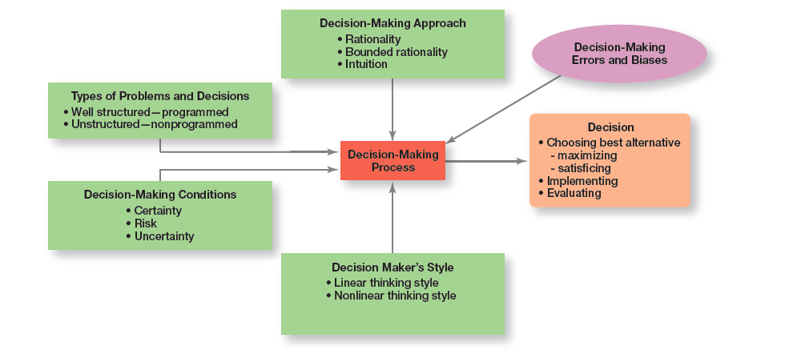
Exhibit 7-12 Overview of Managerial Decision Making
Exhibit 7-12 provides an overview of managerial decision making.
Notes:
Exhibit 2-12 provides an overview of managerial decision-making. Because it’s in their best interests, managers want to make good decisions—that is, choose the “best” alternative, implement it, and determine whether it takes care of the problem, which is the reason the decision was needed in the first place.
Their decision-making process is affected by four factors: the decision-making approach, the type of problem, decision-making conditions, and certain decision-making errors and biases. So whether a decision involves addressing an employee’s habitual tardiness, resolving a product quality problem, or determining whether to enter a new market, it has been shaped by a number of factors.

Slide 22
Guidelines for Making Effective Decisions
Understand cultural differences
Create standards for good decision making
Know when it’s time to call it quits
Use an effective decision-making process
Develop your ability to think clearly
Notes:
Decision-making is serious business. Your abilities and track record as an effective decision maker will determine how your organizational work performance is evaluated and whether you’ll be promoted to higher and higher positions of responsibility. Below are some guidelines to help you be a better decision maker.
Understand cultural differences. Managers everywhere want to make good decisions. However, is there only one “best” way worldwide to make decisions? Or does the “best way depend on the values, beliefs, attitudes, and behavioral patterns of the people involved?”
Create standards for good decision making. Good decisions are forward-looking, use available information, consider all available and viable options, and do not create conflicts of interest.
Know when it’s time to call it quits. When it’s evident that a decision isn’t working, don’t be afraid to pull the plug.
Use an effective decision-making process.
Build an organization that can spot the unexpected and quickly adapt to the changed environment.

Slide 23
Characteristics of an Effective Decision-Making Process
Focuses on what’s important
Is logical and consistent
Acknowledges subjective and analytical thinking, blends analytical with intuitive thinking
Requires only as much information as is needed to resolve particular dilemma
Encourages the gathering of relevant information
Is straightforward, reliable, easy-to-use, flexible
Notes:
Experts say an effective decision-making process has these six characteristics: (1) it focuses on what’s important; (2) it’s logical and consistent; (3) it acknowledges both subjective and objective thinking and blends analytical with intuitive thinking; (4) it requires only as much information and analysis as is necessary to resolve a particular dilemma; (5) it encourages and guides the gathering of relevant information and informed opinion; and (6) it’s straightforward, reliable, easy to use, and flexible.

